Slide 1
Essential Kafka CLI Commands

Slide 2
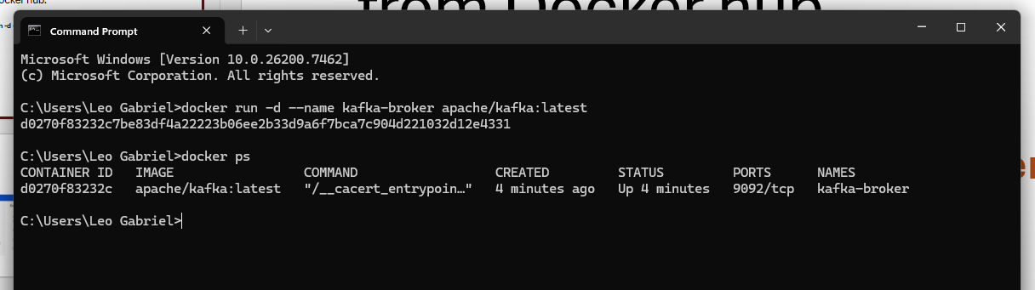
Run and Pull(download) Apache Kafka image from Docker hub.
docker run -d --name kafka-broker apache/kafka:latest

Slide 3
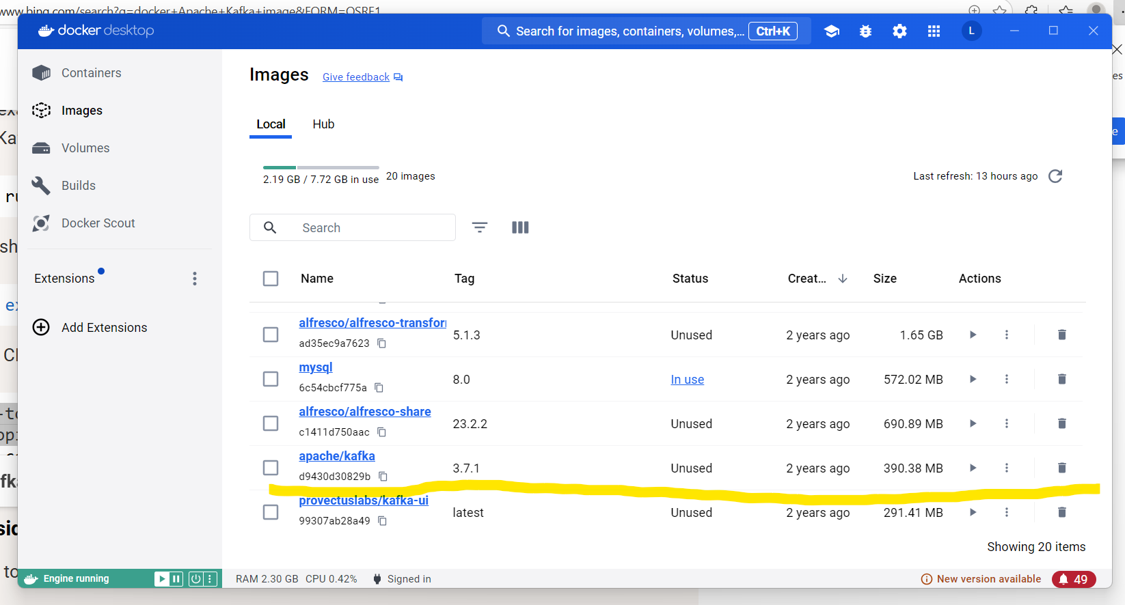
Image view from dockeer desktop

Slide 4
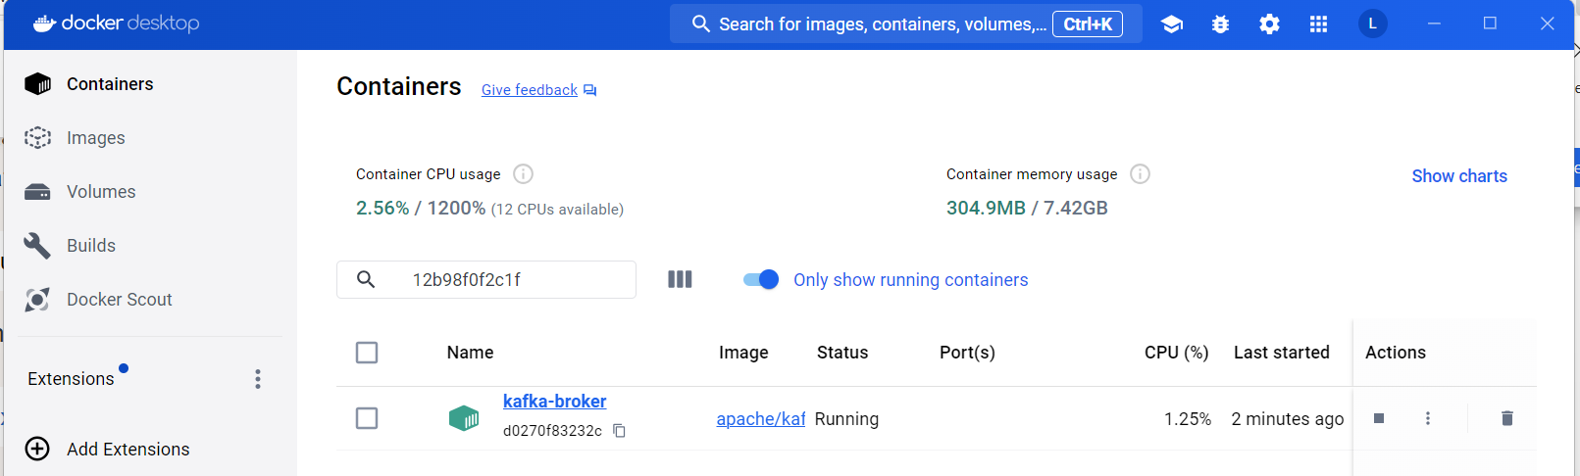
Container view from docker ddesktop

Slide 5
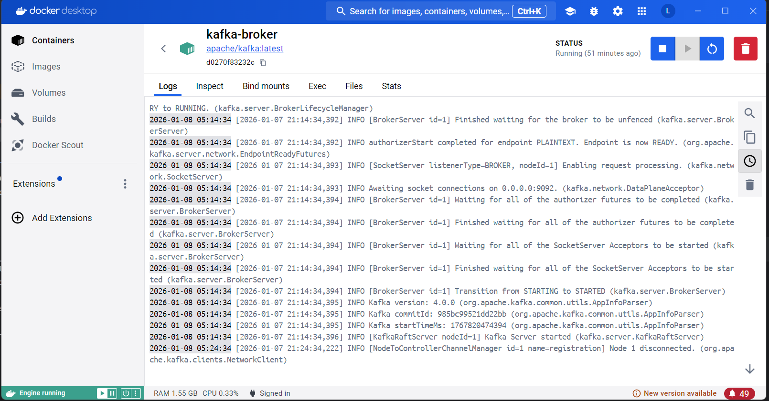
Container Details

Slide 6
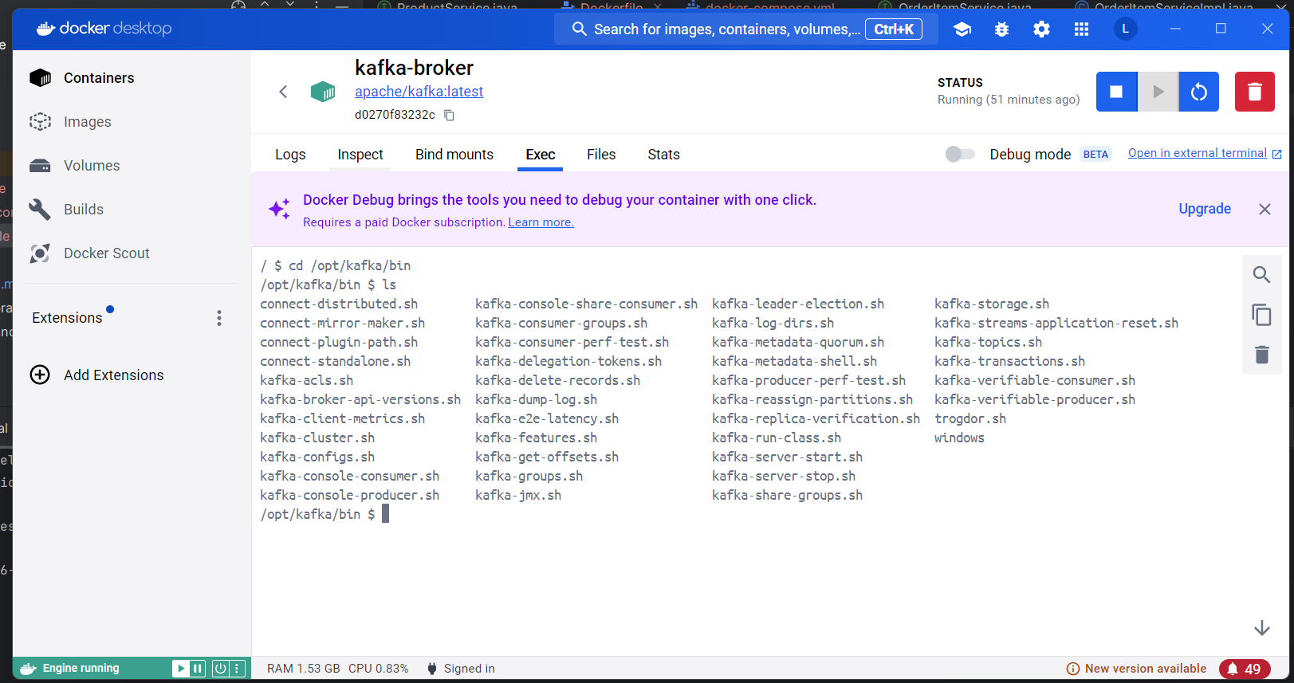
The Exec shell and Kafka bin folder

Slide 7
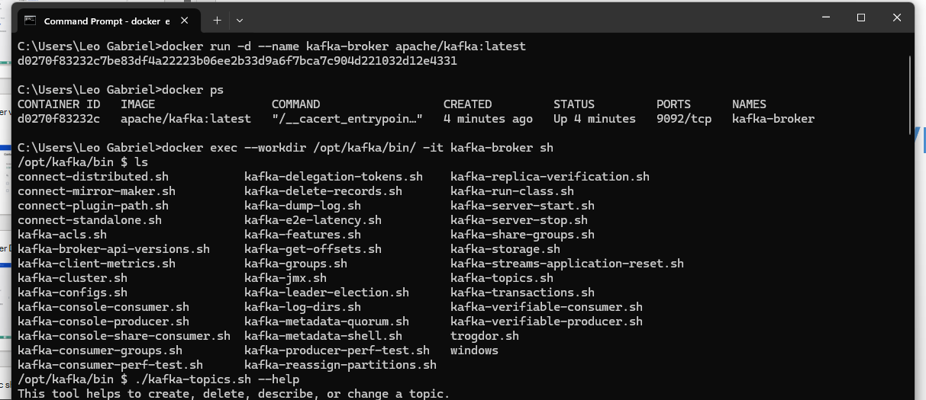
Open a shell inside the container
docker exec --workdir /opt/kafka/bin/ -it kafka-broker sh

Slide 8
Create a topic
./kafka-topics.sh --bootstrap-server localhost:9092 --create --topic javaguides

Slide 9
Publish message to the topic
./kafka-console-producer.sh --bootstrap-server localhost:9092 --topic javaguides

Slide 10
Consume the messages
./kafka-console-consumer.sh --bootstrap-server localhost:9092 --topic javaguides

Slide 11
Exercise in messaging
The project in main.zip contains the following modules
Producer – spring-boot microservice that waits for HTTP requests to send an order. Orders received are serialized and sent to Kafka topic
Consumer - A service that subscribe to a topic from Kafka. Messages received are logged to show they are actually received.
Pssdata - contain the message model class definition that is shared by the producer and the consumer to ensure consistency in interpreting the payload.
Provision a Kafka container in docker to serve as the messaging system.
Use Postman to send a message to the Producer which will then send the message to Kafka and consumed by the Consumer.

Slide 12
Requirement
1. Modify the Order class to represent a real ecommerce order by adding the items ordered.
2. Modify the consumer module to store the order to the database
3. Create another consumer that updates the inventory by reducing the amount of stocks in the DB as a result of items being sold.

Slide 13
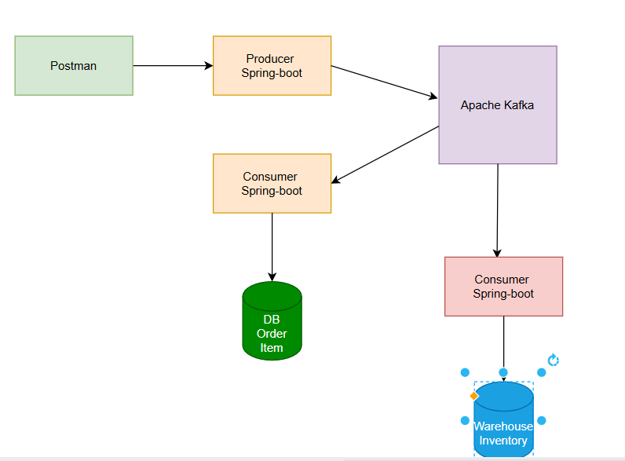
Context

